Slide 1
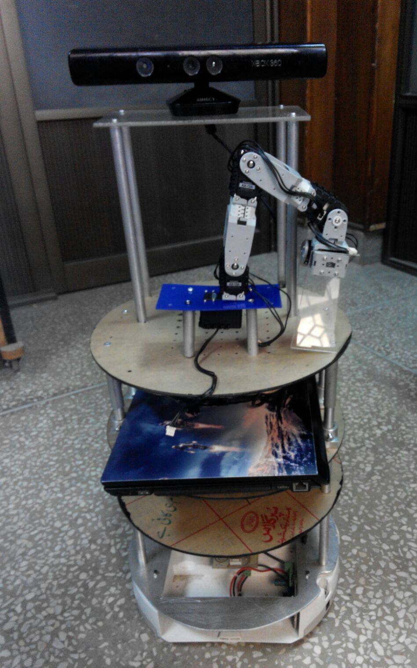
Intelligent Driving System
Amal, Minha, Anila, Maria & Rabeel

Slide 2
Organization of the competition
Stage system
Organised in two stages each consisting of a number of specific tests.
Ends with the Finals
Stage I: comprehends a set of Ability Tests, an Integration Test, and an audience demonstration called Following & Guiding
Stage II: more complex abilities or combinations of abilities are tested

Slide 3
Face Recognition
Person Recognition
A person is introduced to the robot, The robot needs to learn what the person looks like.
Once the robot has gathered enough information, the person mixes within a crowd
The robot needs to find the person
Once the robot has found the person, it must state some information about the personand the crowd, such as genders

Slide 4
International Journal of Advanced
study of Face Recognition Techniques(Issue-17 December-2014)
Methods | Recognition Time (sec.) | Recognition Rate (%)
PCA(Principal Component Analysis) | 24.13 | 98.99
KPCA(Kernel PCA) | 20.33 | 94.99
LDA (Linear Discriminant Analysis) | 33.80 | 97.99
LEM(Line edge map) | 5.07 | 96.00
Comparison of various methods/algorithms on the basis of recognition rate and recognition time.

Slide 5
Face Recognition (2014)
Comparison of various techniques across multiple attributes and recognition accuracies
Partition | PCA | ICA | KPCA | Bayesian method
Accuracy | 77% | 77% | 87% | 95%
Complexity | 10x8 | 10x9 | 10x9 | 10x8
Uniqueness | yes | no | yes | yes
Projections | linear | linear | nonlinear | linear
Std. Dev | 2.21 | 7.66 | 3.39 | 1.69

Slide 6
International Journal of Advanced Research
Face Recognition Using PCA (Principal Component Analysis) and LDA (Linear Discriminant Analysis) Techniques
LDA(Linear Discriminant Analysis) | PCA (Principal component analysis)
LDA can perform face recognition for a single input image; hence it does not consider multiple input images. | based on multiple face images as input. Hence it considers multiple input images.
less sensitive | more sensitive
takes very less computational time | takes more computational time
finds the axes with maximum variance for the whole data | find the axes for best class seperability
comparison of both LDA and PCA techniques and found that PCA is best as compared to LDA
. LDA can give the effective results combining with PCA
March 2015

Slide 7
IP camera(Most Innovative camera in 2015)
Cognitec introduces the FaceVACS-VideoScan C5:an IP video camera boasting built-in face detection and tracking technology
The new camera integrates with Cognitec’s real time face recognition product FaceVACScan.The software which Cognitec says is ground-breaking detects and identifies person’s interest in real time
Other features include anonymous facial analysis overtime, which allows the software to compute people count and movement patterns and detect frequent visitors and crowds

Slide 8
How is it Innovative?
Cognitec: optimal image quality for face-recognition tasks even in challenging conditions.
Low bandwidth exposure with control in facial area
Where in IFSEC International can I find it?
Stand C420

Slide 9
SUMMARY OF RESEARCH PAPERS
The common face detection methods are: knowledge-based approach, Statistics-based approach and integration approach with different features or methods
The knowledge-based approach [Feng, 2004; Faizi, 2008] can achieve face detection for complex background images to some extent and also obtain high detection speed, but it needs more integration features to further enhance the adaptability
Statistics-based approach [Liang et al., 2002; Wang et al., 2008] detects face by judging all possible areas of images by classifier, which is to look the face region as a class of models, and use a large number of “Face” and “non-face” training samples to construct the classifier.
The method has strong adaptability and robustness, however, the detection speed needs to be improved, because it requires test all possible windows by exhaustive search and has high computational complexity

Slide 10
Continued
The AdaBoost algorithm [Zhang, 2008; Guo & Wang, 2009] arose in recent years; it trains the key category features to the weak classifiers, and cascades them into a strong classifier for face detection. The method has real-time detection speed and high detection accuracy, but needs long training time.
Proposed methodology is connection of two stages – Face detection using Haar Based Cascade classifier and recognition using Principle Component analysis. Various face detection and recognition methods have been evaluated [Faizan Ahmad et al., 2013] and also solution for image detection and recognition is proposed as an initial step for video surveillance

Slide 11
Continued
Implementation of face recognition using principal component analysis using 4 distance classifiers is proposed in [Hussein Rady, 2011]. A system that uses different distance measures for each image will perform better than a system that only uses one. The experiment show that PCA gave better results with Euclidian distance classifier and the squared Euclidian distance classifier than the City Block distance classifier, which gives better results than the squared Chebyshev distance classifier.
Prototype is designed to work with web cameras for the face detection and tracking system based on open source platforms Arduino and OpenCV. The system is based on AdaBoost algorithm and abstracts faces Haar-Like features. This system can be used for security purpose to record the visitor face as well as to detect and track the face. A program is developed using OpenCV that can detect people's face and also track from the web camera [The SIJ Transactions on Computer Networks & Communication Engineering (CNCE), Vol. 1, No. 3, July-August 2013]

Slide 12
Face Detection and Tracking using OpenCV and Haarcascade classifier
Face detection is performed fairly easily and reliably with Intel’s open source framework called OpenCV. This framework has an in- built Face Detector that works in roughly 90-95% of clear photos of a person looking forward at the camera. However, detecting a person’s face when that person is viewed from angle is usually harder, sometimes requiring 3D Head Pose Estimation and using a webcam
Face recognition algorithm PCA (Eigenfaces)

